Slide 1
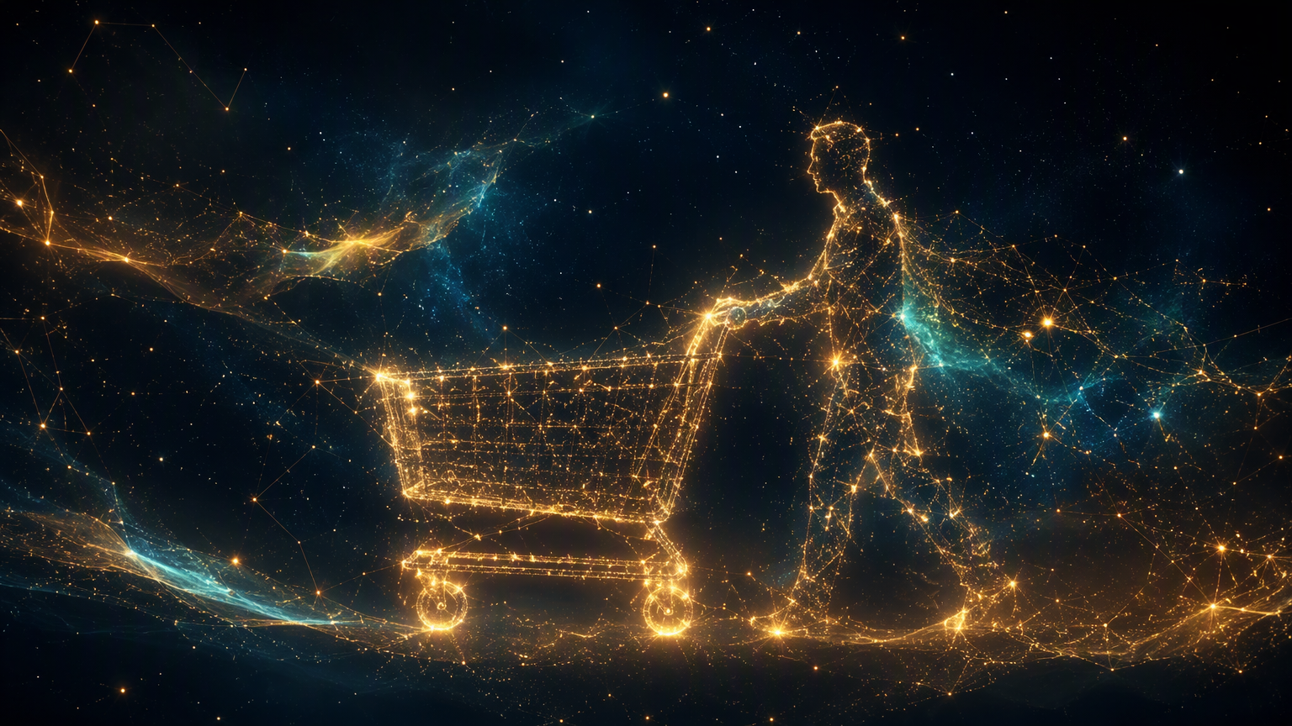
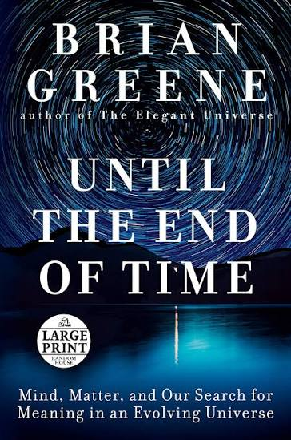
MARKETING IN PRACTICE
THE FUTURE OF COMMERCE
Notes:
Think of the last thing you bought online. Raise your hand if, in the moment, it genuinely felt like your idea.”
"Keep your hand up if you'd told no one about it, seen no ad, and gotten no recommendation before buying.”
"This session is about what actually happened in the three weeks before that purchase."

Slide 2

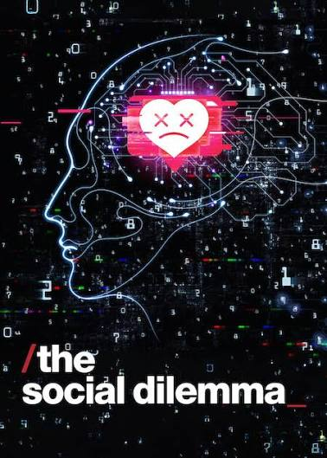

Notes:
Creative Intuition & Storytelling
Tapping into raw human emotion and universal desires to sell a lifestyle.Print, TV, radio, and multi-martini client lunches.Brand Awareness
Reach, catchphrases, and cultural resonance.
Moneyball Era
(2000s–2010s)Data-Driven Efficiency
Applying statistical analysis to media buying, abandoning "gut feelings" for hard metrics.
A/B testing, Google Analytics, SEO, and social ad managers.Performance Metrics
Click-through rates (CTR), CAC, and ROAS.
The AI Era
(Present Day)Predictive Hyper-Personalisation
Using machine learning to anticipate consumer needs and automate content creation.Predictive AI, generative copy tools, and dynamic creative optimization.Customer Lifetime Value
Retention, predictive conversion, and dynamic engagement.

Slide 3
Is your next purchase already decided?
Humans are made of elementary particles. Those particles follow strict mathematical laws, past conditions fully determine every future outcome, leaving no space for a conscious mind to intervene. Even quantum randomness does not rescue free will a purely random event is no more "chosen" than a determined one.
DETERMINISM
RANDOMNESS
Every state follows from the past. Particles obey math like falling dominoes.
Quantum events are probabilistic but chance is not a choice either.
DO WE CHOOSE?
Why a marketer should care
Swap "particles" for "consumers" and "physical laws" for "algorithms + data". Then ask is the purchase decision the last piece of free will left?
GREENE'S VERDICT
no free will either way
Source physics argument · Brian Greene, Until the End of Time (2020)
02 / 14

Slide 4
From physics to the shopping cart
PHYSICS · Determinism
PHYSICS · Quantum randomness
COMMERCE · Predictive algorithms
COMMERCE · Market shocks
THE CONSUMER IS A PARTICLE
PHYSICS · Fields & forces
PHYSICS · Apparent randomness
COMMERCE · The value network
COMMERCE · Engineered spontaneity
03 / 14

Slide 5

If the data is complete, the purchase is inevitable
Determinism in commerce: know the initial state (your data) + the laws (the algorithm) → the future (the purchase) is computable.
The illusion of choice
Algorithms decide what you see, when you see it, and at what price. Your "choice" happens inside an environment built before you arrived.
Hyper-personalization as a physical law
Know your sleep patterns, stress biometrics and history → your next buy stops being a decision. It becomes a consequence of prior inputs.
Anticipatory logistics
Amazon has patented "anticipatory shipping" goods move to local hubs before you click. Practical determinism the system acts before your "will" to buy.
Example · Amazon "anticipatory shipping" patent (2013), as discussed in lecture notes
04 / 14

Slide 6
Anatomy of a purchase that was never a choice
DATA INPUTS
YOUR PROFILE
PREDICTION
THE TRIGGER
PURCHASE
sleep · biometrics · purchase history
you, reconstructed as a model
your next action, computed
the ad · the price · the timing
an "inevitable" click
"Like falling dominoes, every brain state is a direct result of prior physical events."
05 / 14

Slide 7

03 · RANDOMNESS
Black swans what no algorithm saw coming
True randomness = an event with no prior cause. It cannot be predicted only mapped with probabilities.
The black swan event
A crisis, freak weather event or viral trend has no historical data trail. Deterministic AI cannot see it and consumer behaviour is scrambled overnight.
Algorithmic anomalies
The wild, uncharacteristic purchase (storm, meme, broken phone) is not read as free will it is statistical noise, a chaotic variable to be mapped.
Probabilistic target clouds
Modern marketing quotes cohorts, not people "82% probability this demographic converts under this stimulus." The particle cloud replaces the individual.
06 / 14

Slide 8
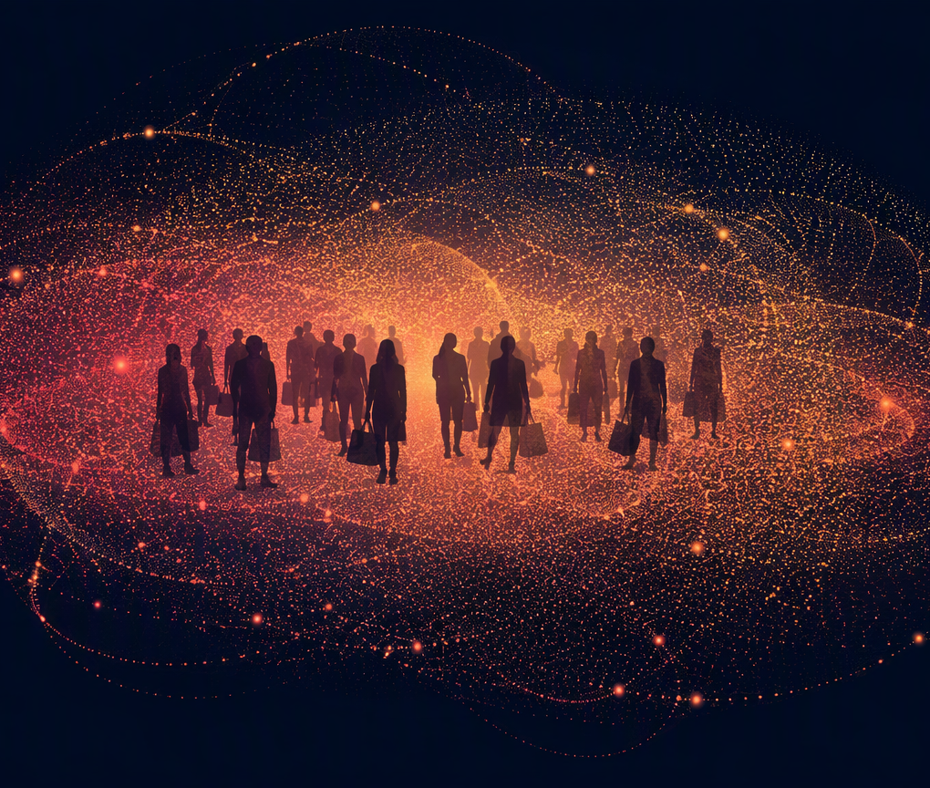
When exact prediction fails, probability takes over
PREDICT ONE PERSON, EXACTLY
MODEL THE COHORT AS A CLOUD
HEDGE THE SUPPLY CHAIN
"70% chance this ZIP code buys umbrellas tomorrow" →
stock enough to cover the cloud, never the whole map.
Quantum rule, commerce edition: probabilities, not certainties.
The electron cloud: where any single shopper lands is unknown — the shape of the crowd is not.
07 / 14

Slide 9
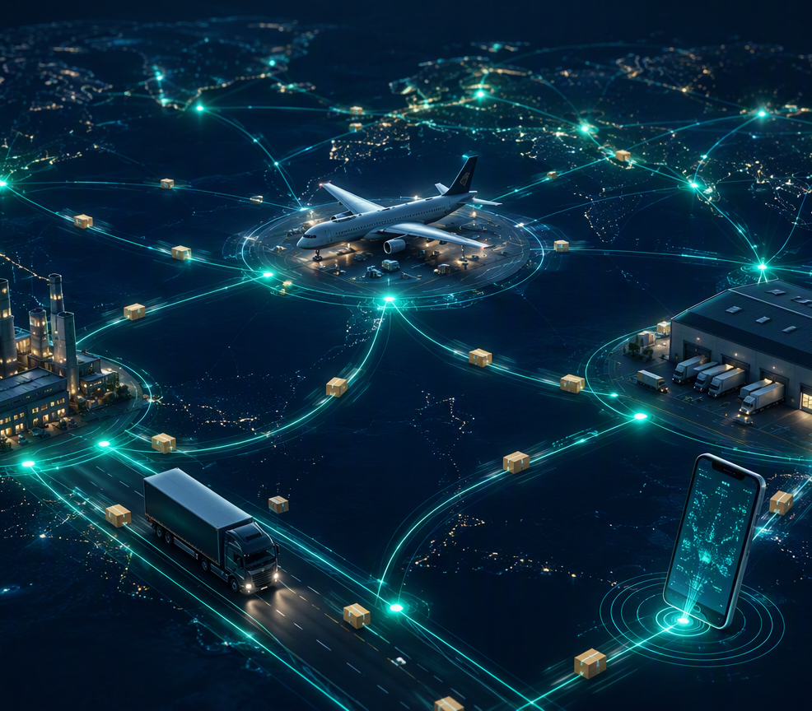
The value network is commerce's physical grid
Value network = the interconnected web of suppliers, algorithms, logistics and platforms. It works like the physical grid of Greene's universe the environment that dictates how consumer particles move.
Network constraints
A particle cannot move where space does not exist. A consumer cannot buy what the network fails to predict, stock or surface. The network sets the boundary conditions of "choice".
Deterministic synchronization
One click automatically triggers raw-material ordering, factory scheduling and shipping. The "choice" is not an isolated event it is a single gear turning a massive, pre-programmed machine.
08 / 14

Slide 10
Your click turns a pre-programmed machine
THE VALUE NETWORK
RAW MATERIALS ORDERED
FACTORY RESCHEDULED
ONE CONSUMER CLICK
INVENTORY REPLENISHED
DELIVERY DISPATCHED
The purchase is not the end of the machine it is the machine turning.
09 / 14

Slide 11

Lucky find? Luck is manufactured
True spontaneity does not exist in marketing. A "spontaneous purchase" is a deterministic response to a hidden network trigger engineered to feel random.
Flash sales
Artificial urgency forces an immediate, emotional reaction. The countdown timer is a physics nudge, not an opportunity.
The "serendipity" algorithm
The feed surfaces an "unexpected" product so you feel you discovered it by luck bypassing your analytical defenses.
Capitalising on friction
Phone breaks → the winner is not the brand that convinces you, but the one with the closest inventory and fastest delivery network.
10 / 14

Slide 12
The loop how randomness becomes revenue
1 · PURE RANDOMNESS
2 · NETWORK ABSORBS
3 · ENGINEERED SPONTANEITY
· sudden storm
· viral trend
· celebrity sighting
No historical data nobody, human or algorithm, saw it coming.
· computer vision + social listening ingest the event
· inventory recalibrated
· feeds re-ranked
· app pushes a "discovered" rain-jacket promo
· purchase captured
Feels like luck. Was recalibration.
absorb
monetise
Randomness is the catalyst · the value network is the converter · determinism is the monetiser.
11 / 14

Slide 13
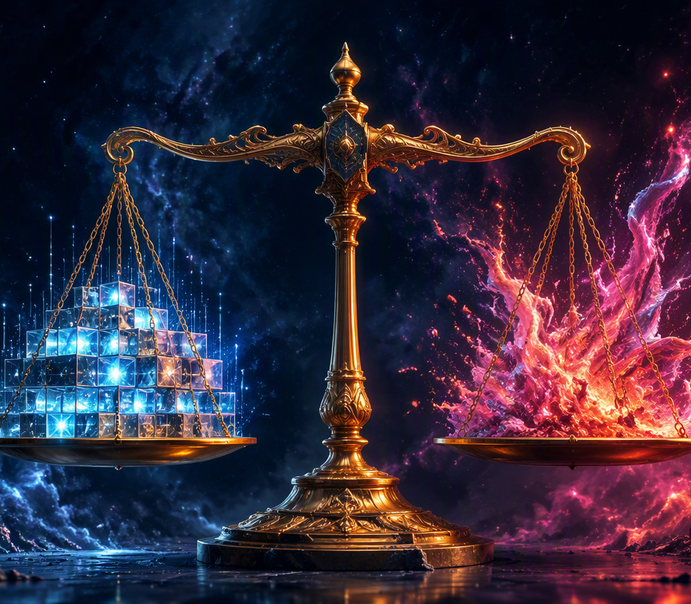
Too much order stagnates; too much chaos collapses
ONLY DETERMINISM → STAGNATION
Marketing becomes boring and repetitive. The brand is hyper-exposed to sudden market shifts, and it cannot innovate it can only re-predict what has already happened.
ONLY RANDOMNESS → COLLAPSE
A supply chain that cannot predict anything drowns in inefficiency stockouts, wasted capital, and ultimately a network that fails to deliver at all.
Winning formula: automated deterministic baseline + agile network that absorbs shocks + algorithm-served spontaneity.
12 / 14

Slide 14
The future of commerce, mapped
DETERMINISM
RANDOMNESS
predict the consumer · personalize the stimulus · pre-ship the product
black swans scramble behaviour · cohorts modelled as probability clouds · inventory hedged, never certain
FUTURE OF COMMERCE
VALUE NETWORK
ENGINEERED SPONTANEITY
sets the boundaries of choice · synchronizes supply to every click · the grid particles move on
flash sales · serendipity feeds · friction capture — calculated nudges that feel like luck
Marketing's goal is no longer to change minds, it is to build a network so precise that desire is predicted, captured and monetised before the consumer knows it exists.
13 / 14

Slide 15
TOPIC 1 · TIMELINE, PART 1 OF 2
1979–2009: from experiments to a trillion-dollar industry
Videotex — Michael Aldrich demos online shopping via modified TV (UK)
PayPal founded — digital payments infrastructure arrives
Amazon Prime launches ($79/yr) — loyalty rewires shipping expectations
First Singles' Day (11.11) — event commerce is invented; >$84B GMV by 2021
1979
1998
2005
2009
1995
1999
2007
Amazon opens ("Earth's Biggest Bookstore"); eBay founded — marketplace & catalogue models born
Alibaba founded — China's e-commerce giant emerges
iPhone launches — the m-commerce era begins
Source: research brief §1.5 milestone table; pre-2022 entries are standard, verifiable company history (company about-pages). Singles' Day GMV is company-reported.
Future of Commerce · BBA
Week 1 · Session B · Topic 1
17

Slide 16
TOPIC 1 · TIMELINE, PART 2 OF 2
2010–2026: feeds, a pandemic, then machines that shop
COVID-19: US e-commerce +42% YoY; Facebook & Instagram Shops launch — a decade of adoption in months
Alibaba IPO (then-largest ever, $25B); Amazon Echo announced — voice hardware arrives
TikTok Shop launches in the US (Sept) — social commerce goes transactional in the West
ChatGPT Instant Checkout (Sept 2025); AI-referred traffic converts 54% better (2026)
2014
2020
2023
2025–26
2018
2022
2024
Instagram shoppable tags; L'Oréal buys ModiFace — social checkout + AR try-on converge
ChatGPT launches (Nov) — the generative-AI wave begins; interface #5 gestates
Amazon Rufus (Feb–Sept); Perplexity Buy with Pro (Nov) — AI assistants meet in-chat checkout
Sources: Adobe via Digital Commerce 360, 2026; OpenAI timeline via Darkroom, 2026; Perplexity, 2024; US Census via SellersCommerce, 2025.
Future of Commerce · BBA
Week 1 · Session B · Topic 1
18

Slide 17
TOPIC 1 · FRAMEWORK
The retail evolution continuum: channels layer, not replace
1 · Brick-and-mortar
pre-1994
2 · E-commerce
1994–2007
3 · M-commerce
2007–2015
4 · Social & conversational
2015–2023
5 · Agentic
2024 →
Interface: physical store
Unlocks: geographic assortment
Walmart, Macy's
~80%
of global retail still physical, 2025
Interface: desktop browser
Unlocks: unlimited shelf, price comparison
Amazon, eBay, Alibaba, Flipkart
16.1%
US e-commerce share of retail, 2024
Interface: smartphone app
Unlocks: commerce anywhere; app ecosystems
Starbucks app, Uber, Myntra
57–59%
of e-commerce sales on mobile, 2025
Interface: feed + chat
Unlocks: discovery-led purchase, live selling, chatbots
TikTok Shop, WeChat, Meesho
$1.6T
global social-commerce market, 2025
Interface: AI agent
Unlocks: delegated search, comparison, purchase
Amazon Rufus, ChatGPT, Perplexity
39%
of consumers use AI for product discovery, 2025
Apply it in 3 steps: ① map the company's revenue share by interface · ② name the constraint each new interface removed (shelf space → location → attention → effort → delegation) · ③ ask which constraint the next interface removes. Caveat: eras overlap — the continuum describes interfaces, not calendar decades.
Sources: framework per research brief §1.2; stats: US Census Bureau, 2025 · Statista, 2025 · Mordor Intelligence, 2026 · Salesforce, 2025
Future of Commerce · BBA
Week 1 · Session B · Topic 1
19

Slide 18
TOPIC 1 · GLOSSARY
Seven terms, precisely defined learn them once, use them all course
Term | Definition and one example
E-commerce | Buying/selling goods, services, funds or data over an electronic network — primarily the internet; B2C, B2B, C2C, D2C, any device. Example: any Amazon order.
M-commerce | The subset of e-commerce transacted on handheld devices via mobile web or apps; marked by location-awareness, push notifications, biometric payment. Example: ordering in the Starbucks app.
Social commerce | Buying and selling directly within social platforms — discovery, evaluation and checkout in the same app. Example: TikTok Shop. Distinct from social-influenced commerce, where social only sends traffic elsewhere.
Conversational commerce | Commerce through dialogue interfaces — messaging apps, chatbots, voice assistants — where the conversation itself is the storefront. Example: reordering via WhatsApp chat or Alexa.
Agentic commerce | An AI agent autonomously performs multi-step shopping tasks — interpreting goals, searching, comparing and (with permission) transacting — on the buyer's behalf. Example: ChatGPT Instant Checkout.
Headless commerce | Architecture decoupling the customer-facing front end from back-end commerce logic, joined by APIs — one engine can serve web, app, kiosk, voice or AI-agent fronts. Example: a Shopify back end powering a custom app.
Omnichannel / channel mix | Deliberate allocation of assortment, marketing and fulfilment across channels, managed as one integrated customer experience rather than competing silos. Example: buy online, pick up in store.
Future of Commerce · BBA
Week 1 · Session B · Topic 1
25

Slide 19
TOPIC 1 · THEORY · ROGERS, 1962
Diffusion of Innovation: adoption is a bell curve, growth an S
The theory in one paragraph
Everett M. Rogers, Diffusion of Innovations (1962; 5th ed. 2003), synthesised 500+ diffusion studies. Any population adopts a new technology in a predictable order — innovators (2.5%) → early adopters (13.5%) → early majority (34%) → late majority (34%) → laggards (16%) — so cumulative adoption always traces an S-curve.
Five attributes set the speed
Relative advantage · compatibility · complexity (reversed) · trialability · observability
Chasm (Moore, 1991): many technologies stall between early adopters and the early majority
Source: Rogers, E. M., Diffusion of Innovations, 1962/2003 (Free Press) — adopter shares are the book's canonical figures; Moore, G., Crossing the Chasm, 1991.
Future of Commerce · BBA
Week 1 · Session B · Topic 1
26

Slide 20
TOPIC 1 · COMPANY EXAMPLE · AMAZON
Amazon: the only company that has crossed all five eras
Thirty years of layering
~37.6%
1994–95 · Founded; opens as "Earth's Biggest Bookstore" (era 2 pioneer)
2000 · Marketplace opens — catalogue + platform in one
2005 · Prime ($79/yr) rewires shipping expectations
2006 · AWS — infrastructure becomes a product
2014 · Echo announced — voice hardware bet (era 4)
2024 · Rufus launches (Feb beta, Sept full US) — era 5 from inside the incumbent
2025–26 · "Buy for me" agent pilots; AI review highlights
of the US e-commerce market — 6× the share of #2 Walmart
~250M
Rufus users and ~14% of Amazon searches by late 2025 (company commentary + analyst estimate — directional)
Why it matters: Amazon shows the continuum's layering logic inside one firm — each new era was added on top of the last, funded by the previous era's profits and data. First-mover advantage plus relentless infrastructure investment is the hardest combination to catch.
Sources: Statista via SellersCommerce, 2025 (US share); Amazon earnings via Jarvio, 2025 (Rufus); timeline per research brief §1.5/§1.8.
Future of Commerce · BBA
Week 1 · Session B · Topic 1
34

